Slide 1
What is computer???

Slide 2
THE COMPUTER DEFINED
In basic term, a computer is an electronic device that processes data, converting it into
information that is useful to people. Any computer- regardless of its type- is controlled by programmed instructions, which gives the machine a purpose and tell it what to do.

Slide 3
TYPES OF COMPUTER
1. PERSONAL COMPUTER
2. MAINFRAME COMPUTER
3. MINICOMPUTER
4. SUPER COMPUTER

Slide 4
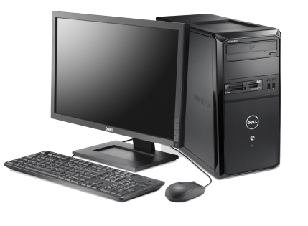
PERSONAL COMPUTER
The most common types of computer is personal computer- a personal computer that is designed to sit on a desk or table. These are the systems you see all around you, in school, homes, and office.
Today’s personal computers are more powerful than those of just a few year’s ago. Not only do these machine enable people to do their jobs with greater ease and efficient, but they can be used to communicate, produce music, edit photographs and videos, etc. the main components of the personal computer is the system units.

Slide 5
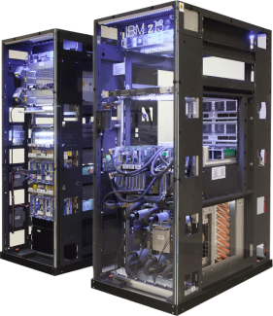
MAINFRAME COMPUTER
Mainframe computer are used in large organizations such as insurance companies and banks, where many people frequently need to use the same data. In a traditional mainframe environment, each user accesses the mainframe’s resources through a device called a terminal. There are two types of terminals. A dumb terminal does not process or store data; it is simply an input/output device that functions as a window into a computer located somewhere else. An intelligent terminal can perform some processing operations, but it usually does not have any storage. In some mainframe environments, however, workers can use a standard personal computer to access the mainframe.

Slide 6
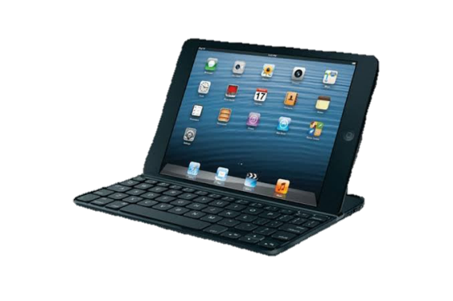
MINICOMPUTER
First released in the 1960s, minicomputers got their name because of their small size compared to other computer of the day. The capabilities of a minicomputer are somewhere between those of mainframe and personal computers. For this reason minicomputers are often called midrange computers.

Slide 7
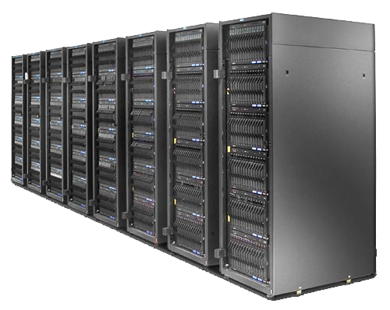
SUPERCOMPUTER
Supercomputers are the most powerful computers made, and physically they are some of the largest. These systems can process huge amounts of data, and the fastest supercomputers can perform more than one trillion calculations per second.

Slide 8

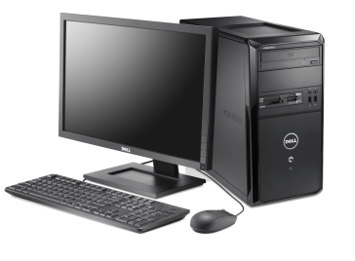
PARTS OF THE COMPUTER SYSTEM
A complete computer system consists of mainly three parts.
Hardware (The computer)
Software (Programs)
Data (Information)

Slide 9
Software
Software is a set of instructions that makes the computer perform tasks. In other words we can say that, software tells the
computer what to do. Here the program refers to any piece of software
Types of Software
System Software
Application Software
Utility Software

Slide 10
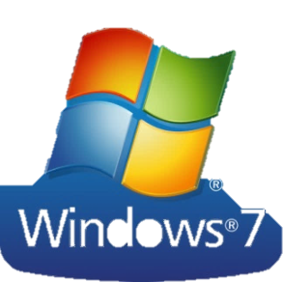
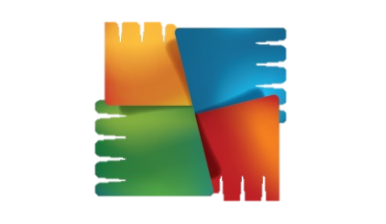

System Software
Those Software which are Used to provide interface between user and hardware is known as system software ex. Operating System
Application Software
Those Software which are Used to Perform a Particular Task is known as Application Software ex. Adobe Flash Player
Utility Software
Those Software which are Used as a helping tool for our convenience is known as utility software ex. Antivirus

Slide 11
Other Software's
1. Freeware Software - Freeware software is available without any cost. Any user can download it from the internet and use it without paying any fee. Ex. Adobe Reader
2. Shareware Software - It is a software that is freely distributed to users on a trial basis. It usually comes with a time limit and when the time limit expires, the user is asked to pay for the continued services. Ex. Winzip
3. Open Source Software - These kinds of software are available to users with the source code which means that a user can freely distribute and modify the software and add additional features to the software. Ex. Linux OS
4. Proprietary Software - Proprietary software is any software that is copyrighted and bears limits against use, distribution and modification that are imposed by its publisher, vendor or developer. Ex. MS Office

Slide 12
Hardware
The mechanical devices that make up the computer are called Hardware. A computer’s hardware consists of interconnected electronic devices that you can use to control the computer’s operation, input, and output.
Assembling a Computer
We have two Option to assemble a PC. We also assemble a Computer System with same brand Components and also different different brands Peripherals.

Slide 13
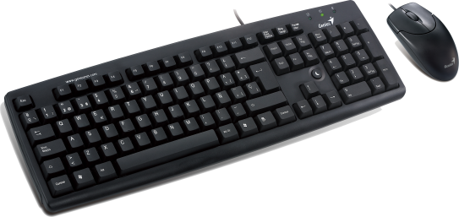
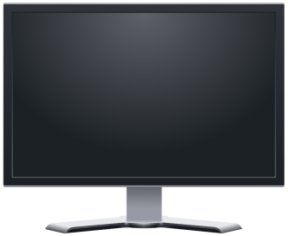
Types of Hardware Devices
1. Input Devices :- Those Devices Which are used to give input in computer system are known as Input Devices
2. Output Devices :- Those Devices Which are used to take Output as result of our Input in our Computer System are known as Output Devices

Slide 14


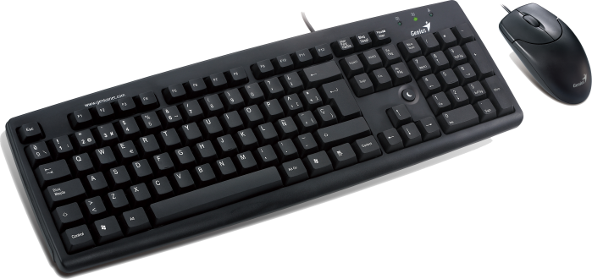




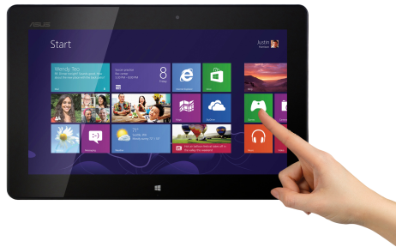


Keyboard
Mouse
Trackball
Graphics tablet
Game Controllers
Touch screen
Webcam
Microphone

Slide 15
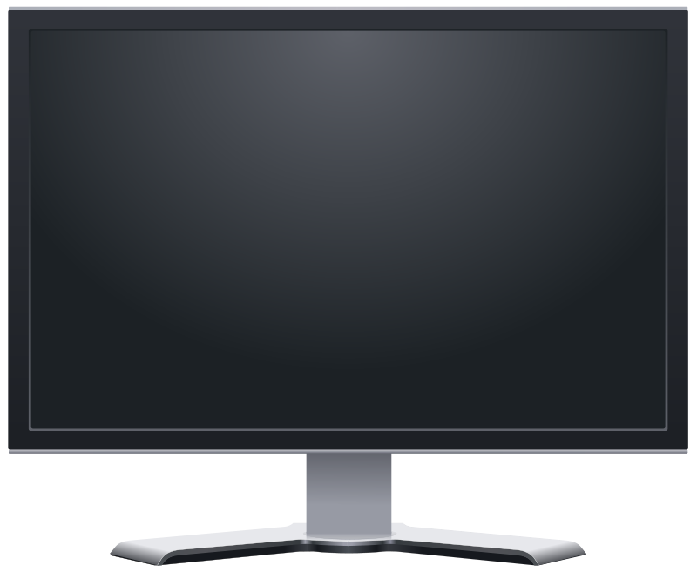
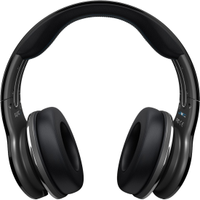
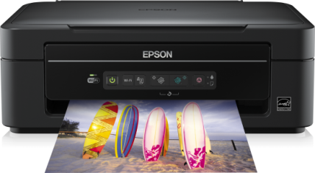
Monitor
Printer
Audio Speaker
Headphones
Projector
GPS
Sound Card
Video Card

Slide 16

What is Monitor?
A Monitor is an Output Device used to display the output as result.
There are 5 Basic Types of Monitors :-
1. CRT – (Cathode Ray Tube)
2. LCD – (Liquid Crystal Display)
3. LED – (Light Emitting Diode)
4. TFT – ( Thin Film Transistor)
5. AMOLED – (Active Matrix Organic Light Emitting Diode)

Slide 17


MONITORS
 CRT- Cathode - Ray Tube The cathode ray tube (CRT)
 vacuum tube containing an electron gun (a source of electrons)
 fluorescent screen with internal or external means to accelerate and deflect the electron beam
 LCD Display - Liquid Crystal Display A liquid crystal display (LCD)
 thin, flat panel used for
electronically displaying information

Slide 18
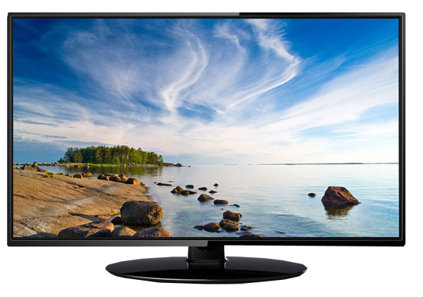
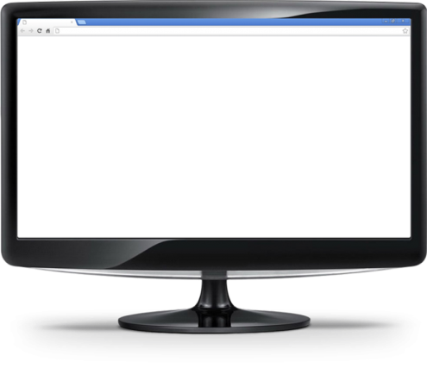
 LED – Light Emitting Diode
 instead of having a normal CCFL backlight, it uses light-emitting diodes (LEDs) as a source of light behind the screen.
 TFT – Thin Film Transistor
 each pixel is controlled by from one to
four transistors.
 Uses chemical and electrical properties
to create a visible image on a screen.

Slide 19

 AMOLED – Active Matrix Organic Light Emitting Diode
 The OLED display contains an LED which is comprised of an organic material that emits light when the current is passed through it. It is used to display rich and vibrant colors.

Slide 20
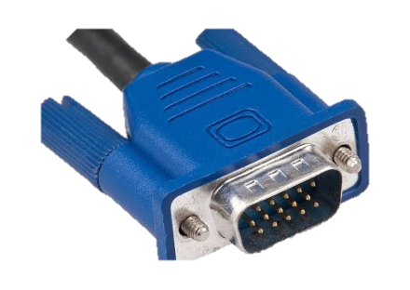
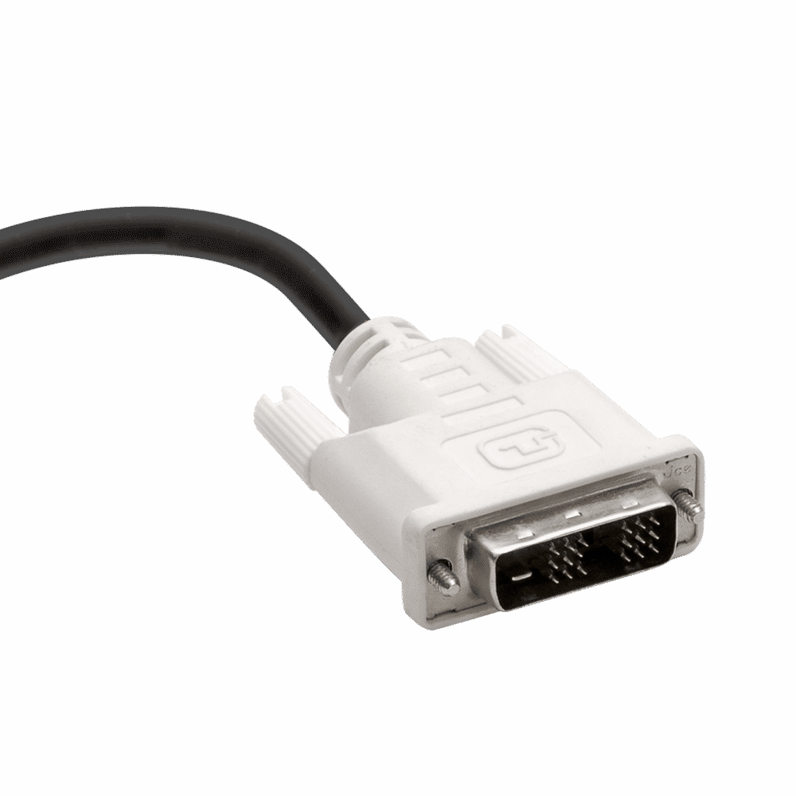
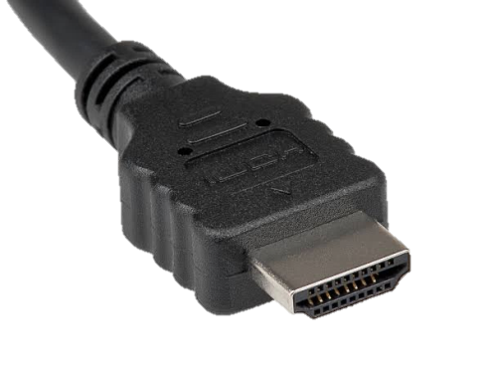
Types of Connectors in Monitors
VGA – (Video Graphics Array)
15 pins Only VIDEO
DVI – (Digital Video Interface)
24 pins VIDEO & AUDIO
HDMI – (High Definition Multimedia Interface)
19 pins HD VIDEO & AUDIO

Slide 21

What is Keyboard?
A Keyboard is a Input Device used to Input in Computer System using some Key Strokes.
There are 5 Basic Types of Keyboards:-
Mechanical Keyboard
Gaming Keyboard
Standard Keyboard
Wireless Keyboard
Multimedia Keyboard
Connectors – PS2 & USB

Slide 22
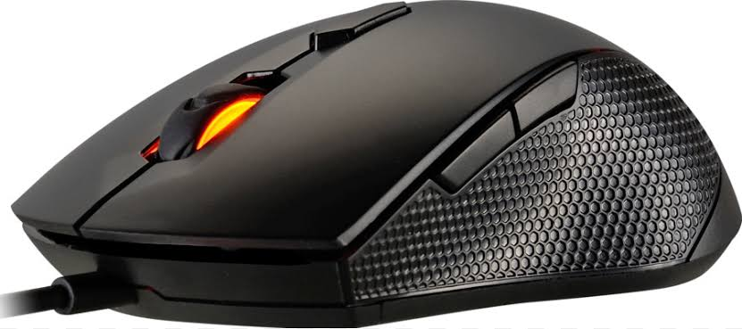
What is Mouse?
A Mouse is a Input Device used to Input in Computer System using a Pointer Arrow
There are 3 Basic Types of Mouse are:-
Mechanical or Trackball Mouse
Optical mouse
Wireless Mouse
Connectors – PS2 & USB

Slide 23
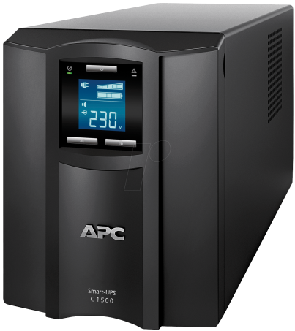
What is UPS?
(Uninterruptible Power Supply) A device that provides battery backup when the electrical power fails or drops to an unacceptable voltage level. Small UPS systems provide power for a few minutes; enough to power down the computer in an orderly manner, while larger systems have enough battery for several hours.

Slide 24
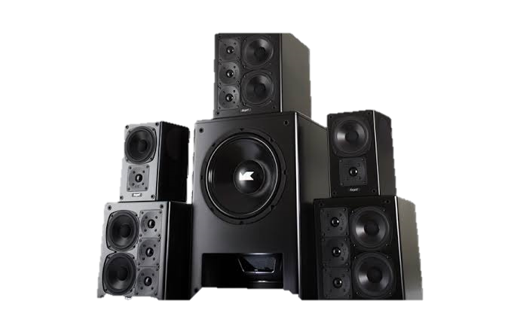
What is Speaker?
A Speaker is a Output Device used to Give Sound as Output. In order to translate an electrical signal into an audible sound, speakers contain an electromagnet: a metal coil which creates a magnetic field when an electric current flows through it.

Slide 25
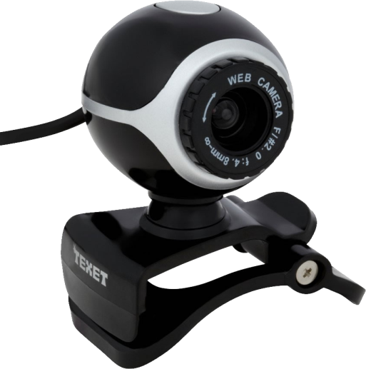
What is Webcam?
Webcams are typically small cameras that either attach to a user's monitor or sit on a desk. Most webcams connect to the computer via USB
Types of Webcams :-
Integrated Webcam
Webcam with Microphone
Stand alone Webcam
Network Cameras or CCTV

Slide 26
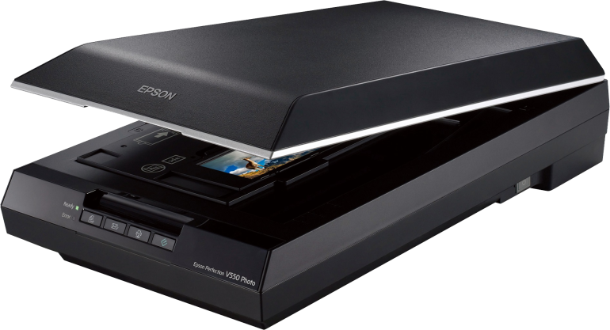
What is Scanner?
A Scanner is an Input Device which converts the hard copy into soft copy. It converts Hard copy into Digital Copy.
Types of Scanners :-
Specialized Scanner
Handheld Scanner
Standard Scanner (Flatbed & Sheet fed)
Scanning Applications

Slide 27
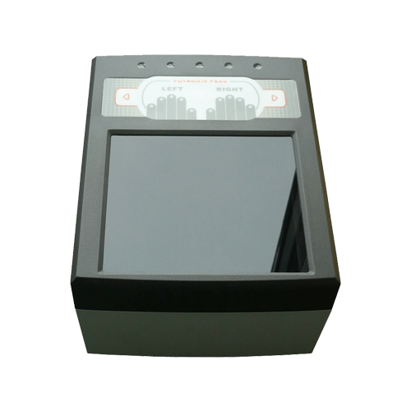
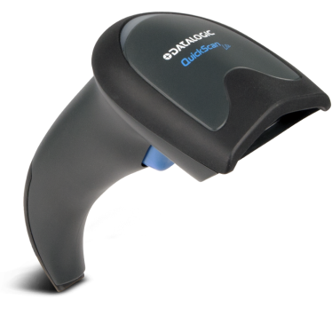
Specialized Scanner
Those Scanners which are used to scan some special documents like. Business card & Metro Card
Handheld Scanner
Those Scanners which are Smaller and easy to hand held and uses to scan a lot of things very quickly like. Barcode Scanner

Slide 28
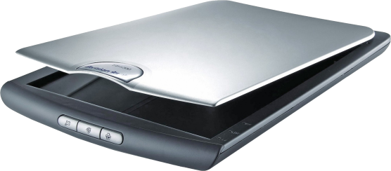
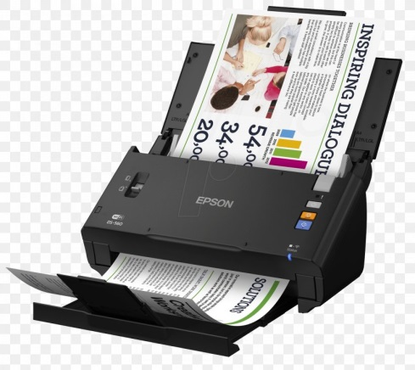
Standard Scanner
Flatbed Scanner
In a Flatbed Scanner the Documents or pages are placed on the screen for scanning. These maybe standalone or integrated in a printer
Sheetfed Scanner
A Sheetfed scanner is a smaller and Portable scanner in comparing of Flatbed You can scan a whole book using sheetfed scanner

Slide 29

Application Scanner
Those Scanners which need Mobile Phone to be Operate like CamScan & Genius Cam

Slide 30
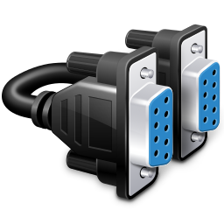
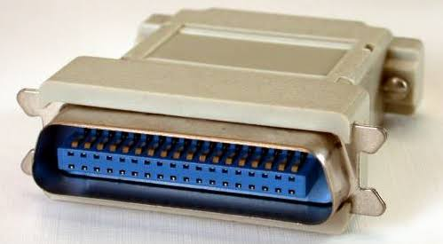
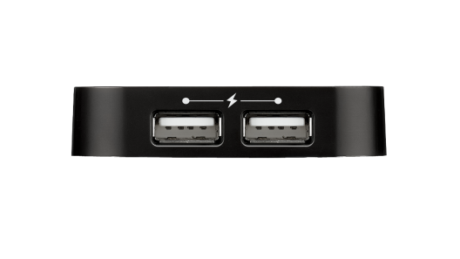
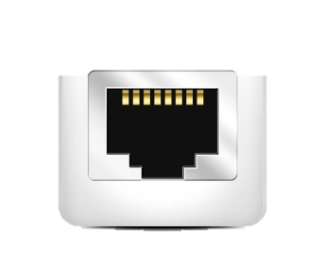

Types of Connectors in Scanners
Serial/Com Port – 9 & 25 pins connector
Parallel Port - 40 pins connector
USB Port – 4 pins connector
LAN Port – 8 pins connector
Wireless – without connector

Slide 31
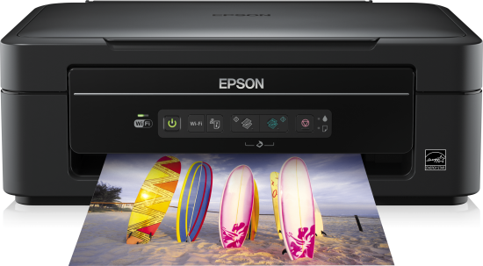
What is Printer?
A Printer is an Output Device which converts the Soft copy into Hard copy. It converts Digital copy into Physical Copy.
Types of Printers :-
Impact Printer :- Impact Printers are those
Printers which have physical contact between the print head, ribbon on
Cartilage and Paper.
2. Non-Impact Printer :- Non-Impact Printers are those
Printers which do not have physical contact between the print head, ribbon
Cartilage and Paper.

Slide 32
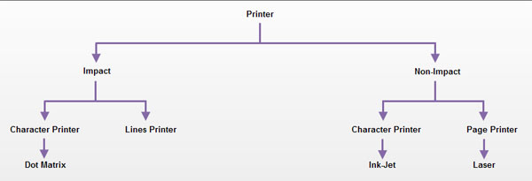
Character Printer :- Those Printer Which Print Paper Character Wise ex. typewriter.
Line Printer :- Those Printer Which Print Paper Line Wise ex. Chain, Drum & Band
Page Printer :- Those Printer Which Print Whole Paper at a Time ex. Laser

Slide 33
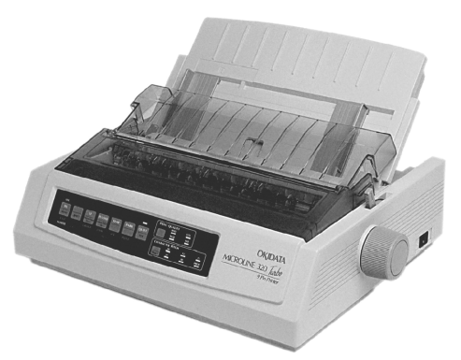
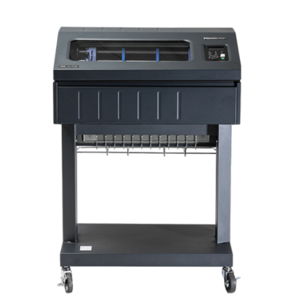
Impact Printers
Dot-Matrix Printer
It has an array of pins which helps to print the paper with tiny Dots ex. Railway Ticket Printer
Speed up to 100 to 600 CPS having 9 to 24 Pins
Line Printer
They are used by Offices where they need to print data at large scale ex. Poster Drum Printer
Speed up to 1200 to 6000 LPM

Slide 34
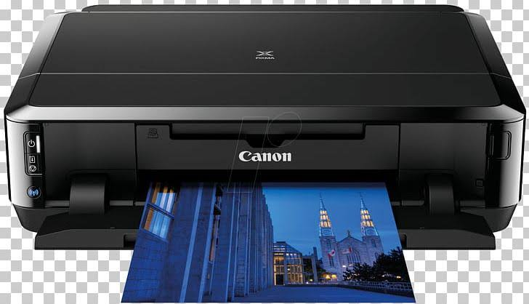
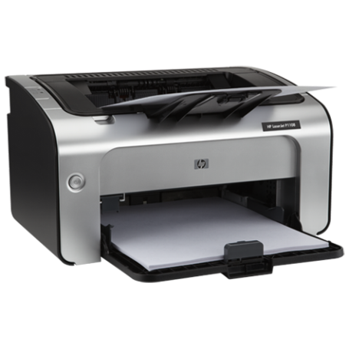
Non-Impact Printers
Ink-Jet Printer
Ink-jet Printer is similar as Dot-Matrix but it doesn’t have any physical contact with External media. It gives Printout with the help of Spray Speed up to 250 CPS.
Laser Printer
Laser Printer Which uses Laser Beam and Heated Toner to produce Printout on a Paper
Speed up to 6000 to 12000 pages per hour

Slide 35
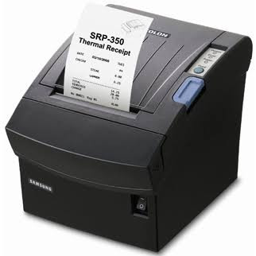
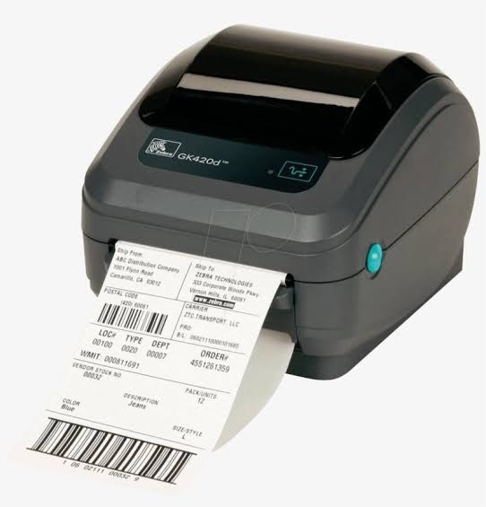
Thermal Printer
A Thermal Printer is one that uses heat to transfer an Impression into paper types of thermal printer
Thermal Wax Transfer Printer – Where a thermal print head melts ink and transfer with the help of ribbon onto paper. After cooling the wax is permanent ex. DTDC Bus Ticket
2. Direct Thermal – Where a printer prints the image by
burning dots onto a coated paper ex. Barcode Generator

Slide 36
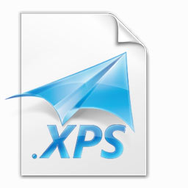
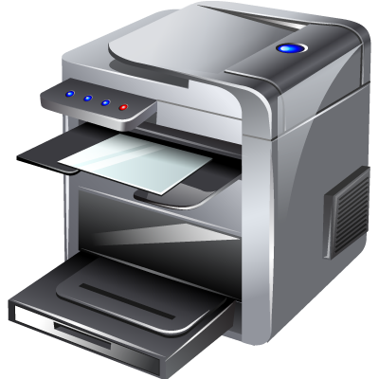
Virtual Printer – A Virtual Printer is a simulated device whose user interface and API are similar to a printer driver, but the device is not connected with a physical printer ex. Microsoft XPS Document Writer, Cute PDF Writer
Multi Functional Device(MFD) – It is also known as
all in one Printer. This is a combination of various
functionalities like Printer, Scanner and Photocopy etc.
TIP -
Type SERVICES.MSC in cmd to show the running Printing processes also allow to restart and stop processess

Slide 37
Types of Connectors in Printers
Serial/Com Port – 9 & 25 pins connector
Parallel Port - 40 pins connector
USB Port – 4 pins connector
LAN Port – 8 pins connector
Wireless – without connector

Slide 38
Components of Computer
CPU or Microprocessor
Motherboard
RAM or Memory
HDD & SDD
ODD or DVD Writer
SMPS

Slide 39
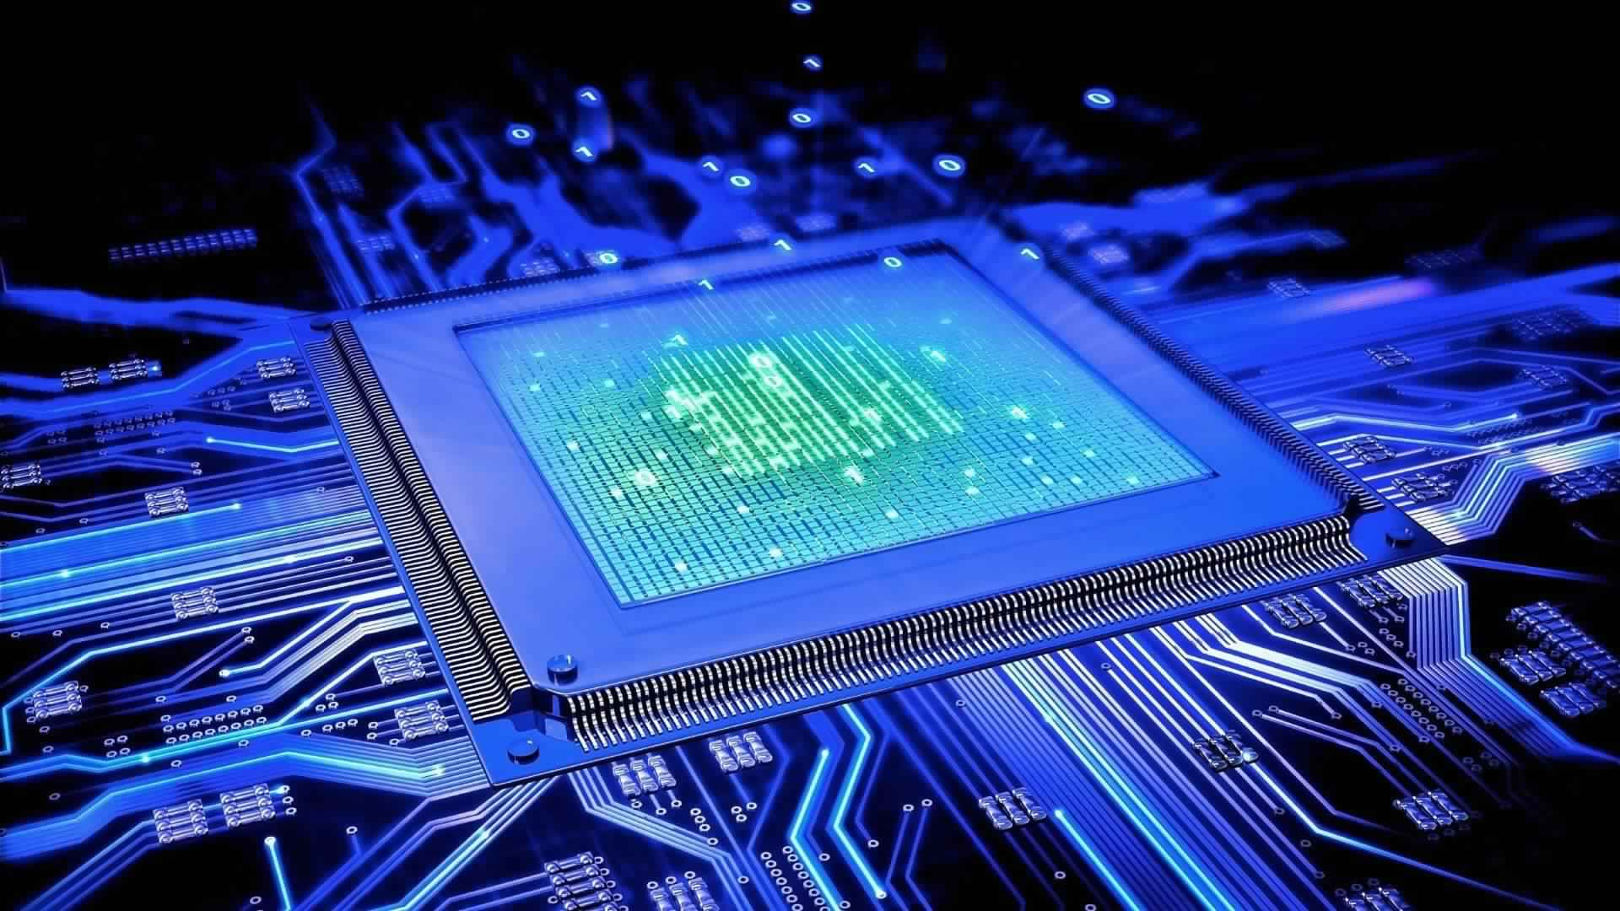
MOTHERBOARD
EVERYTHING ABOUT MOTHERBOARD
Patiently designed by. Adarsh Tomar

Slide 40
PCB
MOTHERBOARD OR PRINTED CIRCUIT BOARD

Slide 41
WHAT IS
It is known as the Interconnection of Components in a computer
MOTHERBOARD
It is a Circuit board which have ports and sockets with transistors coating to connect components together
It is responsible for contact of flow of data and instruction with the help of BUSES
Two types of Motherboard 1. Plane 2. Mark

Slide 42
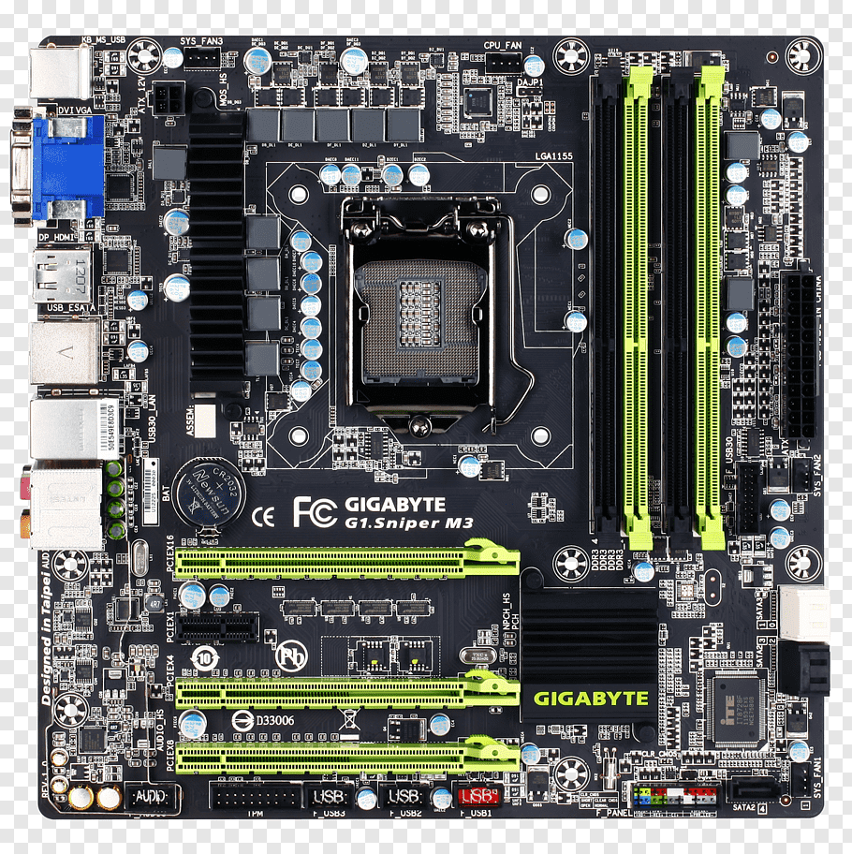

Slide 43
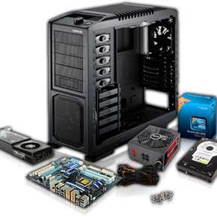
SEGMENTS OF MOTHERBOARD
CATEGROIZED INTO 2 DIFFERENT SEGMENTS
INTEGRATED MOTHERBOARD
NON-INTEGRATED MBOARD
COMES WITH ALL PARTS INTEGRATED WITH IT
ADD SOME OTHER PARTS OR PARTS AS PER REQUIREMENT.

Slide 44
MAJOR BRANDS
DESKTOP
MBOARD
LAPTOP
MBOARD
SERVER
MBOARD
1.
2.
3.
It is used in Desktop Systems. It comes with Upgradation Capability. We can Upgrade it Easily
It is used in Laptop. All components are placed in limited space. Rare mboard allows Upgradation
It is used in Server. Bigger in size having many ports and designed for high end works

Slide 45
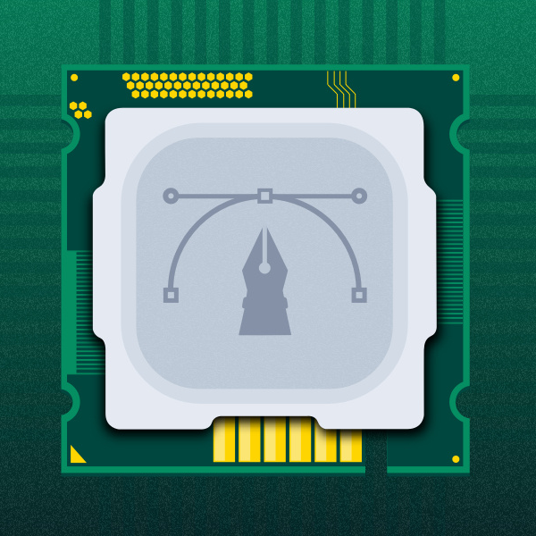
TYPES OF PCB
Mini ATX
Flex ATX
Micro ATX
EATX
Pico ATX
ITX
NLX
BTX
Mobile ATX
WATX

Slide 46

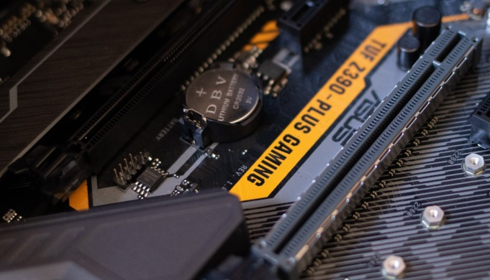
BUSES in Motherboard
DATA BUS :- It Sends and Receives data to Memory.
ADDRESS BUS :- It Sends Address of Inputs to the Memory or RAM
CONTROL BUS :- It Makes the Communication between CPU and Components

Slide 47
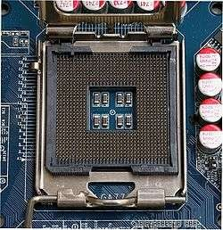
CPU SOCKET
A CPU socket or CPU slot is a mechanical component(s) that provides mechanical and electrical connections between a microprocessor and a printed circuit board (PCB). This allows the CPU to be replaced without soldering.

Slide 48
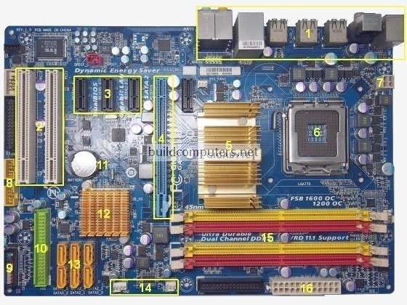

Slide 49
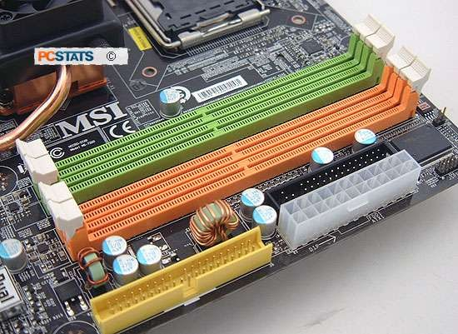
MEMORY SLOTS
A memory slot, memory socket, or RAM slot is what allows computer memory (RAM) to be inserted into the computer. Depending on the motherboard, there will usually be 2 to 4 memory slots (sometimes more on high-end motherboards) and are what determine the type of RAM used with the computer. The most common types of RAM are SDRAM and DDR for desktop computers and SODIMM for laptop computers, each having various types and speeds. In the below picture, is an example of what memory slots may look like inside a desktop computer. In this picture, there are three open available slots for three memory sticks.

Slide 51


CMOS BATTERY
Nonvolatile BIOS memory refers to a small memory on PC motherboards that is used to store BIOS settings. It was traditionally called CMOS RAM because it used a volatile, low-power complementary metal- oxide-semiconductor (CMOS) SRAM (such as Motorola MC146818 or similar) powered by a small battery when system power was off.

Slide 53

ISA, PCI & AGP SLOTS
ISA, or Industry Standard Architecture, is an 8bit or 16bit parallel bus system that allowed up to 6 devices to be connected to a PC. Virtually all IBM-compatible PCs made before the Pentium were based on the ISA (IBM's PC AT) bus. This asynchronous bus architecture uses
16-bit addresses and an 8-MHz clock and handles a maximum data throughput of 2 MB/s to 3 MB/s.

Slide 54

AGP, Accelerates Graphics Port is a high-speed point-to-point channel for attaching a video card to a computer's motherboard. The primary advantage of AGP over PCI is that it provides a dedicated pathway between the slot and the processor rather than sharing the PCI bus.
PCI, Peripheral Component Interconnect bus uses a local bus system; this system is independent of the processor bus speed. The PCI architecture incorporates its own chip set which link the local bus to the main bus, these links are called bridges, there are two bridges which "north and south bridge”

Slide 56

CHIPSET
A chipset is a set of electronic components in an integrated circuit that manages the data flow between the processor, memory and peripherals. It is usually found in the motherboard of a computer.
Chipsets are usually designed to work with a specific family of microprocessors. Because it controls communications between the processor and external devices, the chipset plays a crucial role in determining system performance.

Slide 57


Slide 58

SOUTHBRIDGE
The southbridge is one of the two chips in the core logic chipset on a personal computer (PC) motherboard, the other being the northbridge. The southbridge typically implements the slower capabilities of the motherboard in a northbridge/southbridge chipset computer architecture.

Slide 60

NORTHBRIDGE
The northbridge typically handles communications among the CPU, in some cases RAM, and PCI Express (or AGP) video cards, and the southbridge.[4][5] Some northbridges also contain integrated video controllers, also known as a Graphics and Memory Controller Hub (GMCH) in Intel systems. Because different processors and RAM require different signaling, a given northbridge will typically work with only one or two classes of CPUs and generally only one type of RAM.

Slide 62

GRAPHICs card
A Graphics Card is a piece of computer hardware that produces the image you see on a monitor. The Graphics Card is responsible for rendering an image to your monitor, it does this by converting data into a signal your monitor can understand.

Slide 63

audio card
A sound card is an expansion card or IC for producing sound on a computer that can be heard through speakers or headphones. Although the computer does not need a sound device to function, they are included on every machine in one form or another, either in an expansion slot or built into the motherboard

Slide 64

Nic card
A network interface card (NIC) is a hardware component without which a computer cannot be connected over a network. It is a circuit board installed in a computer that provides a dedicated network connection to the computer. It is also called network interface controller, network adapter or LAN adapter.

Slide 65

BACK PANEL CONNECTORS AND PORTS

Slide 66

PORTS
PS2 MOUSE
LAN
AUDIO PORT
PS2 KEYBOARD
USB 3.0
SERIAL
VGA
USB 2.0

Slide 67

SOME OTHER PORTS
DVI
PARALLEL
HDMI
AUDIO
USB 2.0

Slide 68




CABLES & CONNECTORS
SATA & IDE CABLES
POWER CONNECTION WIRES
CPU FAN WIRE
MOLEX WIRE
SATA & IDE PORT 7 & 40 PINS
20-24 PINS ATX PORT
4 PINS BRY PORT
FOR POWER IN HDD 4 PINS

Slide 69



Slide 70


Slide 71
MICROPROCESSOR
EVERYTHING ABOUT MICROPROCESSOR
Patiently designed by. Adarsh Tomar

Slide 72
CPU
Control Processing Unit

Slide 73
WHAT IS
It is known as the brain of the Computer. It is first priority to run Machine
MICROPROCESSOR
It is a chip based structure made up of millions of transistors and logic gates
It receives the incoming instructions as input from Memory or RAM, Procced it and gives result as Output
It is Responsible for the Speed and Capacity to execute tasks in computer systems
These Microprocessor are Categorized into 2 different architecture 32 BIT and 64 BIT

Slide 74
SEGMENTS OF CPU
CATEGROIZED INTO 2 DIFFERENT SEGMENTS
ARITHMETIC LOGICAL UNIT
CONTROL UNIT
Known as ALU
Known as CU
It performs all the Arithmetic, mathematical, algebraical and logical tasks like Addition, Divide, Multiplication, Subtraction and Modulus. It also performs Logic tasks like OR, AND and NOT
It is responsible for controlling the flow of data between Microprocessor and the external components of the computer using the CPU Buses.
THESE ARE THE FACTORS WHICH MAKES A PROCESSOR TO PERFORM TASKS FREQUENTLY!

Slide 75
BUSES in MICROPROCESSOR
CPU consists 3 Buses mention below. Basically Buses are used as medium or carrier of information or data between the microprocessor and the memory and components of the system. It carries the instruction from memory to CPU & back CPU to memory after processing….
DATA BUS :- It Sends and Receives data to Memory.
ADDRESS BUS :- It Sends Address of Inputs to the Memory or RAM
CONTROL BUS :- It Makes the Communication between CPU and Components

Slide 76

MAJOR SPECIFICATION OF MICROPROCESSOR
Clock Speed :- Clock Speed is a unit to measures the number of instructions executes by the working microprocessor within a second is called Clock speed. It is measured in GHz.
Specifications of CPU
Cache Memory :- It is Static natured and Quick responsive memory, by structural it is made up of 6 Transistors and 1 Capacitors in each cell block. cache Memory are categorized into 3 types L!, L2 and L3
Operating Voltage :- It means how much Power or Voltage a microprocessor needs to performs tasks.
FSB :- It stands for Front Side Bus. It is a data bus which carries the data from RAM to Processor and then back processor to RAM as a procced instruction.
All the Information mentioned upon the Processor

Slide 77
MAJOR BRANDS
INTEL
AMD
NVIDIA
1.
2.
3.
Intel Corporation
AMD (Advanced Micro Devices)
NVIDIA
Intel Corporation is an American multinational corporation and technology company and the biggest manufacturer of microprocessor in the planet earth
Advanced Micro Devices is an American multinational semiconductor company which also makes GPU and the second most selling microprocessor brand across the Globe
NVIDIA is an American technology company It designs graphics processing units for the gaming and microprocessor units for everyone.

Slide 78
HISTORY & PRESENT
INTEL’S 1st Processor
Intel’s 1st Processor was INTEL 4004 which was designed for Calculators
AMD’S 1st Processor
AMD’s 1st Processor was AMD AM9300 which was designed as Competitor of INTEL
INTEL’S Latest Processor
Intel’s latest Processor is INTEL i9 10TH Generation (Socket LGA 2066)
AMD’S Latest Processor
AMD’s latest Processor is RYZEN 9 3000+ Series (Socket AM4)

Slide 79

PACKAGING???
The process of installing the microprocessor in motherboard is known as packaging. In Motherboard there are different different types of packaging for different different types of micro processor……
Packaging is based upon which micro processor you want to install in your system. The processor is install and fix with the Socket in Motherboard….
CPU Installation

Slide 80

SOCKETS FOR CPU
According to Structure Sockets are a collection or a Array of Pins which holds Microprocessor.
Sockets are used to adjust the position of Microprocessor in the Motherboard. These are Categorized according to the Brands and Version of Microprocessors…
INTEL | No. of pins | Processor
LGA | 1151 to 1155 | I3, i5 & i7
PGA | Text | Pentium
PPGA | Text | Text
FC-PGA | Text | Text
AMD | No. of pins | Processor
C Series | Socket C32 | Opteron
AM Series | AM 1 to 4 | Ryzen 3, 5, 7, Phenom, Athlon & Sempron
A Series | Socket A462 | Duron & Athlon
FM Series | FM 1 to 2 | Trinity & Llano

Slide 81

WHY AMD?
Here are some reasons why AMD is Better?
AMD Performance?

Slide 82
SPECIFICATIONS of AMD
Over Clocking
Over Clocking is the process in which we consume more performance then the processor have. you can Simply Over Clock the Performance of AMD Processor up to 4.2 GHz in the latest technology.
Graphics
AMD provide their processor an onboard GPU which provides Superior Graphics without GPU Unit. We can also play Mid range Games and perform High end works like Video Rendering.
EVP (Enhanced Virus Protection)
AMD provides EVP in their processors which makes an anti malware protection from the viruses and protect Microprocessor.
Gaming & Graphics Tasks
AMD is Better for Gaming and Media Production Works because it has full control of threats at a time. Which makes High end performance
Cost
AMD is much cheaper then INTEL and also provides a good performance. If you have lower Budget go with AMD.

Slide 83

Why INTEL?
How?
Why INTEL is the Biggest Brand of
Microprocessors?
Here are some reasons why INTEL is Better

Slide 84
SPECIFICATION of INTEL
Over Clocking
Over Clocking is the process in which we consume more performance then the processor have. you can Simply Over Clock the Performance of INTEL Processor up to 4.4 GHz in the latest technology.
HYPERTHREADING
It is a technology developed by INTEL in which a single physical processor can works as two logical processors.
EDB (Execute Disable Bit)
INTEL provides EDB in their processors which makes a protection from the viruses and protect Microprocessor as similar as AMD’s EVP.
Cores & Threats
INTEL gives 32 Threats of 14 nm technology and 12 Cores in their Latest processor which gives a better experience to the user in multitasking. This is much more in comparing of AMD.
EIST (Enhanced Intel Speedstep Technology)
EIST is a thermal based technology which enhance the microprocessor performance as per the requirement which the users need while work. It can fluctuate performance according to needs just like low performance while office works and high performance for gaming and high end purposes it prevents heat and remove load from processor while we don’t need it.

Slide 85
CONCLUSION
If you are using Laptop go with INTEL because AMD consumes a lots of power and also release a lots of heat. So for Laptops INTEL is Ideal
If you are looking a Budget PC with a High end Performance go with AMD because it is much cheaper then INTEL and also provide onboard Graphics Unit.
If you are a multitasker and runs multiple tasks at same time so, you can go with INTEL because Intel provides more Threats and Cores then AMD which gives you a better Performance.
Both are comes with Virtualization & Turbo Boost Technology Inbuilt which helps to give more then their ability and also runs two OS at a Time.
INTEL have much Better Service in INDIA in Comparing of AMD if you are Purchasing for Company Purposes go with INTEL because In companies work load is too high where processors needs maintenance time by time.

Slide 86

SOLUTION FOR
OVERHEATING
HEAT SINK
When we use system it release a lots of heat. To prevent and Release heat we install Heatsink in our Motherboard.
Types of Heatsinks :-
Active Heatsink :- Heatsink which have Fan Installed is known as Active Heatsink
Passive Heatsink :- Heatsink which have Fan Installed is known as Passive Heatsink
Heatsink is attached with Microprocessor with the contact of Thermal Paste or Grease Which extremely absorb heat from microprocessor.

Slide 87
MOBILE PROCESSORS
Mobile Processors are similar as Laptop or Desktop Processors but are smaller in size power and capacity. They are specially designed for Portable Devices such as Mobiles, tablet and Calculators etc. They don’t have specs like Overclocking and Turbo Boost. They are Designed for Simple Tasks like Messaging, watching Video or Playing Games etc.
Most Common Processors of Mobile Phones are :-
Huawei Kirin
Qualcomm Snapdragon
Apple A series manufactured by. Samsung
MediaTek Helio
Samsung Exynos
Their Speed is depends upon the size of transistors. The fastest mobile processor transistors size is 11nm introduced by Apple A13

Slide 88
TYPES OF MEMORY

Slide 89


Memory
The memory of the computer is divided into two categories:
Primary Memory
Secondary Memory

Slide 90


PRIMARY MEMORY

Slide 91
Memory
Memory is required in computers to store data and instructions.
Computer memory is any physical device capable of storing information temporarily or permanently.
In computing memory refers to the physical devices used to store programs or data on the temporary or permanent basis for use in a computer or other digital electronic device

Slide 92
PRIMRAY MEMORY
This is the main memory of the computer.
CPU can directly read or write on this memory. It is fixed on the motherboard of the computer.
The main features of primary memory, which distinguish it from secondary memory are −
It is accessed directly by the processor
It is the fastest memory available

Slide 93

TYPES OF MEMORY

Slide 94
ROM
Read only memory
Also known as firmware
Data stored in this memory cannot be modified.
Non-volatile memory
ROM usually stores the startup instructions
When computer is switched on , the first piece of instruction of a program accessed by the CPU is BIOS which is a ROM pre-programmed to start the computer operations

Slide 95

PROM
Programmable read-only memory (PROM), programmable ROM (OTP),
or one-time
Empty of data when the chip is manufactured,
can be programmed by the user.
Once programmed the data cannot be erased.

Slide 96
EPROM
Erasable programmable read-only memory (EPROM)
can be written to or programmed.
can be erased

Slide 97
EEPROM
Electrically Erasable programmable read-only memory (EEPROM)
Can be written to or programmed.
can be erased with the help of electrical devices
So data can be easily modified

Slide 98
Flash Memory
Non – volatile memory
Can be erase electronically & rewritten, Similar to EEPROM
Most computer use flash memory to hold their start-up instructions because it allows computer easily to update its concern

Slide 99

RAM
RAM stands for Random Access Memory.
It gets the word "random" because information can be accessed in non-sequential order.
Though the data itself is stored together, it could be anywhere in the "container" or amount of RAM available.

Slide 100
RAM
RAM (Random Access Memory) is a type of memory that computers use to store data and software to which it needs to access quickly.
It is a volatile memory, that is, the information stored inside vanishes when the computer is turned off

Slide 101
Types of RAM
SRAM
DRAM

Slide 102
SRAM
Static RAM is a type of RAM that holds its data without external refresh, for as long as power is supplied to the circuit.
This is contrasted to dynamic RAM (DRAM), which must be refreshed many times per second in order to hold its data contents.
SRAMs are used for a computer's cache memory

Slide 103
DRAM
Dynamic RAM is the standard computer memory of the vast majority of modern desktop computers.
It is a volatile memory that needs to be refreshed with voltage regularly, otherwise it loses the information stored on it.
Dynamic RAM is also referred to as DRAM. Volatile means that it loses the information stored on it as soon as power is withdrawn

Slide 104


Slide 105
Cache memory
Cache memory, also called CPU memory, is random access memory that a
computer microprocessor can access more quickly than it can access regular RAM.
This memory is typically integrated directly with the CPU chip or placed on a
separate chip that has a
separate bus interconnect with the CPU.

Slide 106
Cache memory
The basic purpose of cache memory is to
store program instructions that are frequently re-referenced by software during operation.
Fast access to these instructions increases the overall speed of the software program.
As the microprocessor processes data, it looks first in the cache memory; if it finds the instructions there (from a previous reading of data), it does not have to do a more time-consuming reading of data from larger memory or other data storage devices.

Slide 107
Cache memory levels
Level 1 (L1) cache
is extremely fast but relatively small, and is usually embedded in the processor chip (CPU).
Very small(8 KB to 128 KB)
Level 2 (L2) cache
External cache as it is external to processor chip
in the motherboard or near the microprocessor
Larger then l1(64KB to 16MB)

Slide 108
Cache memory levels
Level 3 (L3) cache is typically specialized memory that works to improve the performance of L1 and L2.
It can be significantly slower than L1 or L2, but is usually double the speed of RAM.
In the case of multi core processor, each core may have its own dedicated L1 and L2 cache, but share a common L3 cache.
PC have up to 8 MB
But sever may have 8 MB to 24 MB

Slide 109
synchronous DRAM
SDRAM (synchronous DRAM) is a generic name for various kinds of dynamic random access memory (DRAM) that are synchronized with the clock speed that the microprocessor is optimized for.
SDRAM is available in DIMM(dual in line memory module)
Clock speed MHz()

Slide 110
SDRAM Classification
DDR SDRAM
DDR2 SDRAM
DDR3 SDRAM
DDR4 SDRAM

Slide 111
DDR SDRAM:
DDR SDRAM, also known as DDR1 SDRAM
gains its name from the fact that it is Double Data Rate SDRAM.
This type of SDRAM provides data transfer at twice the speed of the traditional type of SDRAM memory. This is achieved by transferring data twice per cycle.
DDR DIMMs have 184 pins
DDR2 SDRAM:
DDR2 is faster version of DDR memory
DDR2 DIMMs have 240 pins
Speed of data transfer 400Mhz to 1066Mhz
Power consumption & heat generation is less

Slide 112
DDR3 SDRAM:
DDR3 SDRAM is a further development of the double data rate type of SDRAM.
It provides further improvements in overall performance and speed.
DDR4 SDRAM: DDR4 SDRAM provides the lower operating voltage (1.2V) and higher transfer rate.

Slide 113



Slide 114

TYPES OF RAM

Slide 115
SD RAM classification
SD RAM | MAXIMUM I/O SPEED | POWER CONSUMPTION | DENSITY
DDR | 266 MBPS | 2.5 V | 128 MB
DDR2 | 400 MBPS | 1.8 V | 256 MB
DDR3 | 1066 MBPS | 1.5 V | 1024 MB
DDR4 | 2133 MBPS | 1.2 V | 2133 MB

Slide 116
SECONDARY MEMORY

Slide 117

INTRODUCTION
WHAT IS HARD DISK?
A HARD DISK DRIVE (HDD) is a data storage device used for storing and retrieving digital information using rapidly rotating disks (platters) coated with magnetic material. An HDD retains its data even when powered off. Data is read in a random-access manner, meaning individual blocks of data can be stored or retrieved in any order rather than sequentially. EXAMPLE OF PRIMARY MEMORY

Slide 118


TYPES OF HDD
SATA (Serial Advanced Technology Attachment) – 7 pins for data 15 pins power 4 pins molex speed upto 600MBPS
SATA 1 - 150 MBPS
SATA 2 - 300 MBPS
SATA 3 - 600 MBPS
IDE (Integrated Drive Electronics) - 40 pins for data 4 pins for Power 4 pins molex speed uto 133MBPS
ATAPI – I - 100MBPS
ATAPI – II - 133MBPS

Slide 119


Slide 120



COMPONETS
1. DISK PLATTER
The platter is made up of a magnetic material, in the flat disk part of the drive.
The data stored in the platter.
Each set of magnetic particles is collection a unit called a bit.
2. STEPPER MOTOR
Use stepper motors for controlling read/write head position.
Stepper motors usually use +12V power, but some new low-power drives use +5V power source.

Slide 121


3. SPINDLE MOTOR
It control the platter.
This motor rotates at a speed of 3600 to 10,000 R.P.M
All the platter moves in the same direction.
4 READ AND WRITE HEAD
The heads read and write the information to the drive platter.
The head writes magnetic information on the platter.

Slide 122
DISK STRUCTURE
TRACK
The HDD is divided into number of concentric circles called tracks. Circular path in sector is called track.
SECTOR
Data storage area in one track multiple divided into the multiple block is called sector. Each sector can have 512 bytes of the data.

Slide 123
FILE SYSTEM IN HDD
1.FAT (File Allocation Table)
It’s not a security.
Partition size is max 32GB.
Does not support data compression.
Does not support disk quota.
2.NTFS (New Technology File System)
It’s a security.
Partition size is 1 (Tera Bytes).
It support data compression.
It support disk quota.

Slide 124

WHAT IS SOLID STATE DISK (SSD)?
A SOLID STATE DRIVE IS A STORAGE DEVICE USED AS SECONDARY MEMORY IT DOESN’T HAVE PLATTER OR ROTATING PARTS IN IT. IT IS MADE UP OF STORAGE ROM CHIPS. THAT’S WHY IT IS FASTER THEN HDD AND ALSO EXPENSIVE IN COMPAIRING OF HDD

Slide 125

WHAT OPTICAL DISK DRIVE (ODD)?
A OPTICAL DISK DRIVE IS A DEVICE USED TO INPUT DVD OR CD INTO COMPUTER SYSTEM. IT USES LASER BEAM TO READ CD DVD. IT IS ALSO KNOWN AS DVD WRITER THREE TYPES OF ODD

Slide 126

WHAT COMPACT DISK(CD)?
A COMPACT DISK IS A STORAGE USED TO STORE DATA IN MAGNETIC FORMS STORES 700MB OF DATA COMES IN READ, WRITE AND RE-WRITE

Slide 127

WHAT COMPACT DISK(DVD)?
A DIGITAL VERSATILE DISK IS A STORAGE USED TO STORE DATA IN MAGNETIC FORMS STORES 4.7 GB IN SINGLE LAYER AND 9.4 GB IN DUAL LAYER OF DATA COMES IN READ, WRITE AND RE-WRITE

Slide 128

WHAT BLU-RAY DISK(BLU-RAY DISK)?
A BLU-RAY DISK IS A STORAGE USED TO STORE DATA IN MAGNETIC FORMS STORES 25GB OF DATA IN SINGLE LAYER AND 50GB IN DUAL LAYER COMES IN READ, WRITE AND RE-WRITE

Slide 129

WHAT IS SWITCHED MODE POWER SUPPLY (SMPS)?
A SMPS IS A DEVICE USED TO INPUT POWER TO ALL COMPONENTS OF MOTHERBOARD IT CONTAINS DIFFERENT COLORS WIRES HAVING DIFFERENT VOLTAGE FOR DIFFERENT COMPONENTS IN CPU CABINET

Slide 130

HOW SMPS WORKS

Slide 131



Slide 132

Cmos battery
CMOS Battery is used to update Date & Time while the system is off
Stands for Complementary Metal Oxide Semi Conductor
Having Connection with RTC and Jumper Settings to RESET BIOS

Slide 133

This is a bios CHIP on motherboard

Slide 134
BIOS
Is a small ROM chip on the PC’s motherboard.
A basic software program containing all BIOS functions is permanently stored in the ROM.
This software functions as a basic operating system.
Is responsible for starting the PC.
This hardware is integrated with software is also referred to as firmware.

Slide 135
BIOS History
Intel developed the 8086 and 8088 in the end of the 70s.
IBM decided to make an affordable computer out of the 8088.
Microsoft created the operating system (DOS).

Slide 136
Functions of the BIOS
When you first turn on your PC
Your PC requires information
to detect PC components
To find the operating system(floppy disk, hard drive, or a CD-ROM)
This information is stored in the BIOS
Bootstrap loader loads Booting Files while Starting Computer
Having 4 tests Start Test, Hard Drive Test, Memory Test & Battery Test

Slide 137
Flow Chart of BIOS Functions
Turn on Computer
Pass through POST Error Free
NO
Output to Monitor
YES
Plug’n’Play
Pass through POST Error Free
Test Boot Drive
NO
Pass through POST Error Free
NO
YES
Bootable media found
Pass through POST Error Free
Load boot program
Start operating system

Slide 138
POST (Power On Self Test)
Takes place right after you power on.
Contains diagnostic routines for
initializing the hardware and peripherals
the video card, the main memory, the processor, the keyboard, etc.
Checking their functions
Error message on screen if an error is detected. If monitor cannot be detected, the beep codes are output by the system loud speaker.

Slide 139
BIOS Updating
The BIOS is manufactured on FLASH technology. It is easily updated.
Previous versions of BIOS were developed on ROM, EPROM , and EEPROM chips.
UPDATE BIOS using Windows executable file or Bootable USB stick

Slide 140
TYPES OF BIOS
Legacy BIOS
Character user Interface
Works only keyboard
Don’t show large storage devices
UEFI BIOS
Graphical user Interface
Works Keyboard & Mouse
Show large storage devices

Slide 141

Legacy bios

Slide 142

Uefi bios

Slide 143


BSOD
A stop error, commonly called the blue screen of death, blue screen, or BSoD, is an error screen displayed on a Windows computer system following a fatal system error. It indicates a system crash, in which the operating system has reached a condition where it can no longer operate safely

Slide 144
TOP BRANDS AND MANUFACTURERS FOR MICROPROCESSOR
AMD
INTEL
NVIDIA
ZILOG
MOTOROLA
TOP BRANDS AND MANUFACTURERS FOR HARD DISK DRIVE
SEAGATE
WESTERN DIGITAL WB
TOSHIBA

Slide 145
TOP BRANDS AND MANUFACTURERS FOR MOTHERBOARD
GIGABYTE
ASUS
ASRock
MSI
BIOStar
TOP BRANDS AND MANUFACTURERS FOR ram memory
CORSAIR
KINGSTON
TRANSCEND

Slide 146
TOP BRANDS AND MANUFACTURERS FOR MONITORS
SAMSUNG
BENQ
DELL
HP
LG
TOP BRANDS AND MANUFACTURERS FOR UPS
MISCROTEK
OKAYA
LUMINOUS

Slide 147
TOP BRANDS AND MANUFACTURERS FOR MOUSE
HP
DELL
LOGITECH
MICROSOFT
TECHNET
TOP BRANDS AND MANUFACTURERS FOR KEYBOARD
QHMPL
LOGITECH
TVS

Slide 148
TOP BRANDS AND MANUFACTURERS FOR DVD WRITER
HP
LG
LOGITECH
PANASONIC
SONY
TOP BRANDS AND MANUFACTURERS FOR SCANNER
EPSON
CANON
FUJITSU

Slide 149
TOP BRANDS AND MANUFACTURERS FOR PRINTER
HP
CANON
EPSON
BROTHER
FUJITSU
TOP BRANDS AND MANUFACTURERS FOR SPEAKERS
INTEX
JBL
LOGITECH

Slide 150

TOP BRANDS AND MANUFACTURERS FOR LAPTOPS
HP
DELL
MSI
ASUS
MICROSOFT
ACER
SAMSUNG
APPLE
LENOVO
TOSHIBA

Slide 151
THANKYOU
I hope you may be Concerned from this video Thanks to listen me carefully. Have a nice day to all of you!
~Adarsh Tomar
Email :- cyberwarriorchannel@gmail.com

